Slide 1



BCAC0010: System Design & Software Engineering
Class Presentations on Introduction to System Design & Software Engineering

Slide 2
Problem Statement
Requirements Elicitation
Requirements Analysis
Requirement Engineering
Requirements Documentation
Requirements Review
SRS
Crucial Process Steps of requirement engineering

Slide 3
Requirements describes the ”what of the system” not “how”.
Requirement analysis phase produces one large document written in a natural language.
The requirement phase translates informal inputs from the users into a set of formal specified requirements.
The process of requirement analysis helps to bridge the communication gap between customer and the developer.

Slide 4
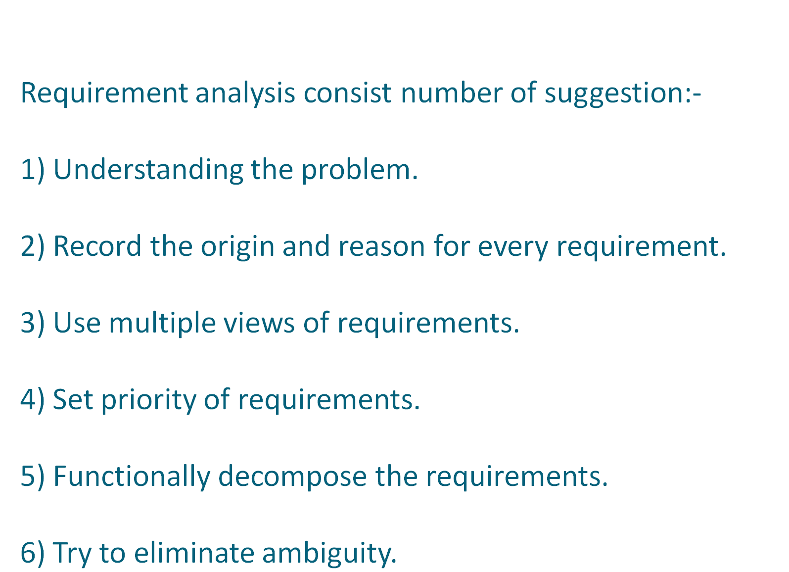

Slide 5
Requirements Analysis
We analyze, refine and scrutinize requirements to make consistent & unambiguous requirements.
Steps
Draw the context Diagram
Develop prototype (optional)
Model the Requirements
Finalize the Requirements
Requirements Analysis Steps

Slide 6
Requirements Analysis
Administrator
Marks Entry Operator
Subject Information Entry
Student Information Entry
Marks Entry
Result Management System
Student Information Reports generated
Mark sheet generated
Student performance Reports generated

Slide 7
Requirements Analysis
Data Flow Diagrams
DFD show the flow of data through the system.
--All names should be unique
-- It is not a flow chart
-- Suppress logical decisions
-- Defer error conditions & handling until the end of the analysis
Symbol Name Function
Data Flow Connect process
Process
Perform some transformation of its input data to yield output data.

Slide 8
Requirements Analysis
Symbol
Name
Source or sink
Function
A source of system inputs or sink of system outputs
A repository of data, the arrowhead indicate net input and net outputs
to store
Data Store
Leveling
DFD represent a system or software at any level of abstraction.
A level 0 DFD is called fundamental system model or context model represents entire software element as a single bubble with input and output data indicating by incoming & outgoing arrows.

Slide 9
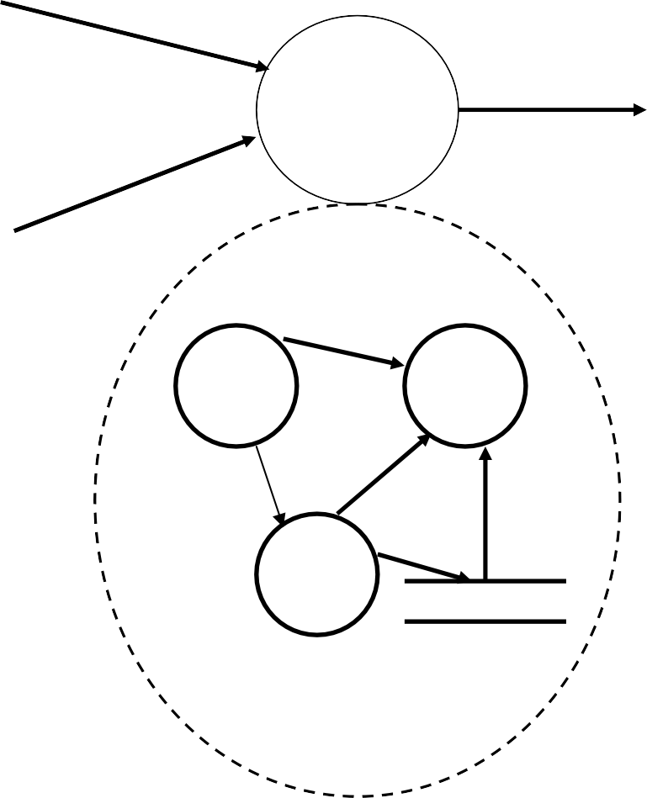
Requirements Analysis
I1
A
O3
I2
I1
O3
I2

Slide 10
Data Dictionaries
DFD DD
Data Dictionaries are simply repositories to store information about all data items defined in DFD.
Includes :
Name of data item
Aliases (other names for items) Description/Purpose
Related data items
Range of values Data flows
Data structure definition

Slide 11
Data Dictionaries
Notation Meaning
x= a+b x consists of data element a & b x={a/b} x consists of either a or b
x=(a) x consists of an optional data element a x= y{a} x consists of y or more occurrences x={a}z x consists of z or fewer occurrences of a
x=y{a}z x consists of between y & z occurrences of a{

